Slide 1
Web Application Development ISCG7420 Introduction to Web Development
School of Computing, Electrical and Applied Technology

Slide 2
Outlines
Django folder structure
Create Django App
Database setup
Views
Templates

Slide 3
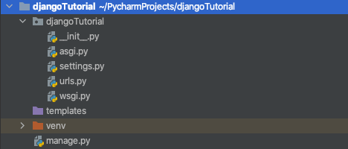
Django Files

Slide 4
manage.py
A command-line utility that lets you interact with this Django project in various ways.
https://docs.djangoproject.com/en/3.2/ref/django-admin/
Create apps
Create superusers
Migrate databases
Run server
python manage.py runserver
…

Slide 5
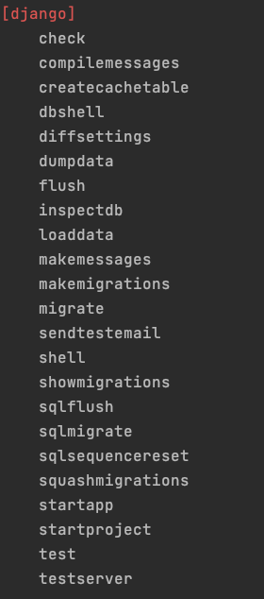
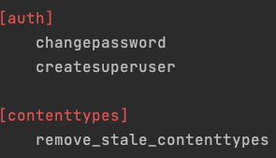
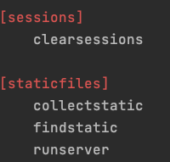
manage.py

Slide 6
__init__.py
An empty file that tells Python that this directory should be considered a Python package.
https://docs.python.org/3/tutorial/modules.html#tut-packages

Slide 7
settings.py
Settings/configuration for this Django project.
https://docs.djangoproject.com/en/3.2/topics/settings/

Slide 8
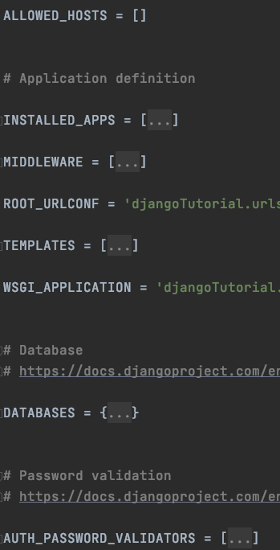
settings.py
* For all people
Register your Django apps
Plugins you need to use
Page Templates location
For server to detect your application
Config your database
Config your authentication method

Slide 9
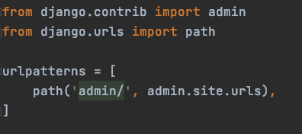
urls.py
The URL declarations for this Django project; a “table of contents” of your Django-powered site.

Slide 10
asgi.py
An entry-point for ASGI-compatible web servers to serve your project.

Slide 11
wsgi.py
An entry-point for WSGI-compatible web servers to serve your project.
For your Procfile when you deploy your work on SAAS

Slide 12
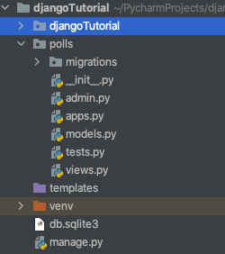
Creating the Polls app
python manage.py startapp polls

Slide 13
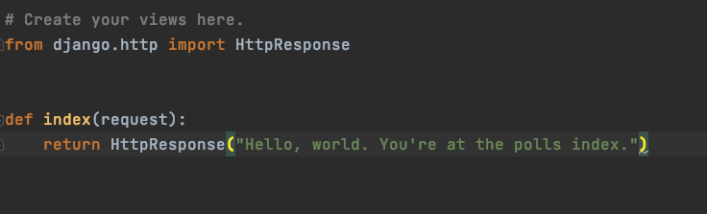
Create your first view
polls/views.py

Slide 14
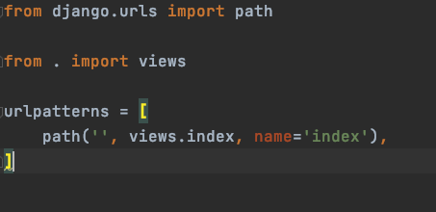
Register your view to urls.py
Create a file urls.py inside folder polls
polls/urls.py

Slide 15
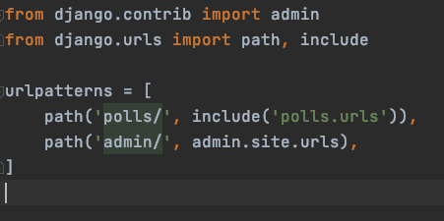
Add your app urls to project urls
yoursite/urls.py

Slide 16
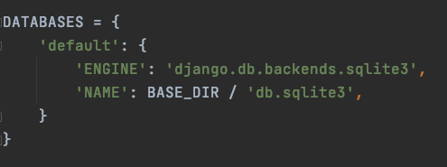
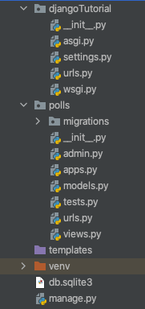
Database setup

Slide 17
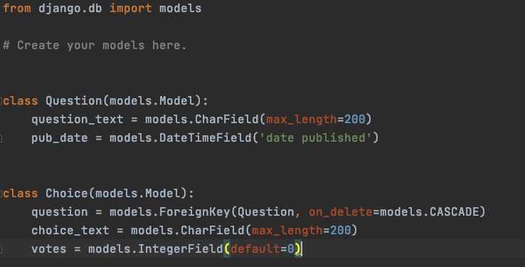
Create your models
polls/models.py

Slide 18
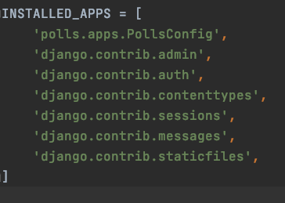
Activating models
Register your app in INSTALLED_APPS in setting file

Slide 19
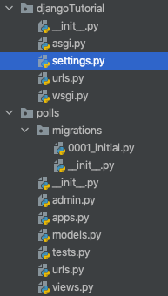
makemigrations
python manage.py makemigrations polls

Slide 20
makemigrate
python manage.py sqlmigrate polls 0001
python manage.py migrate

Slide 21
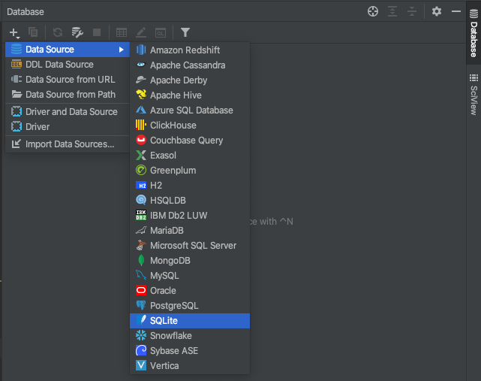
Connect to database

Slide 22
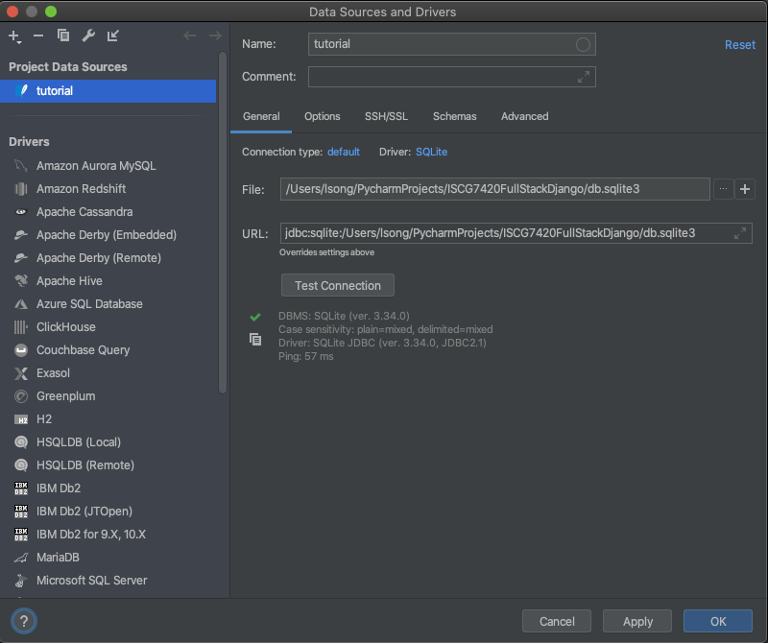
Connect to database

Slide 23
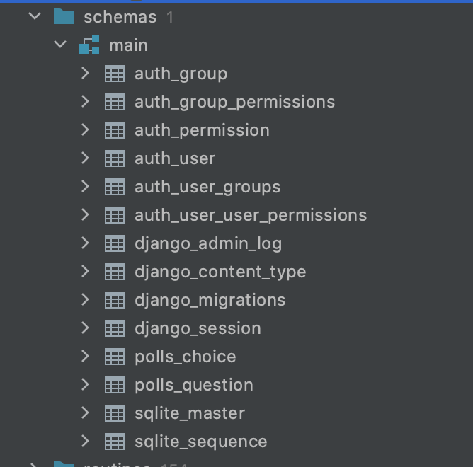
Find your new tables

Slide 24
Creating an admin user
python manage.py runserver

Slide 25
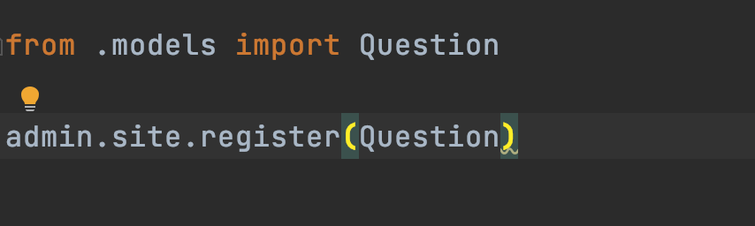
Add polls to Admin
polls/admin.py

Slide 26
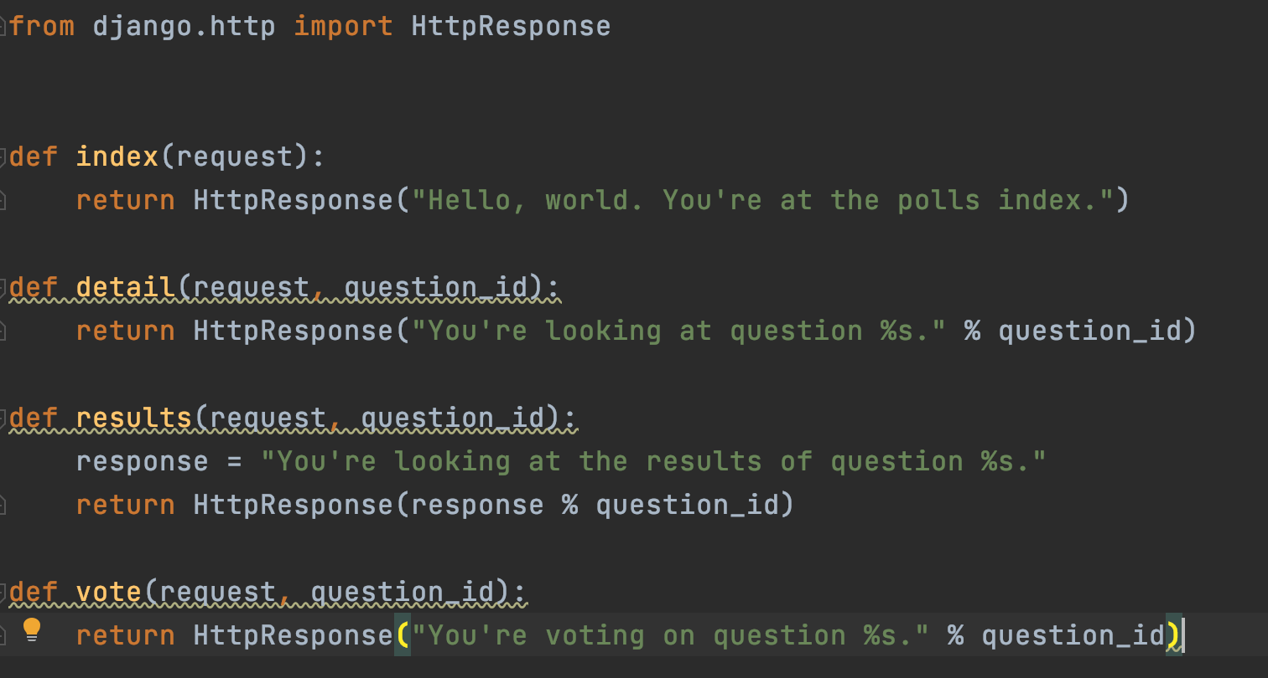
Writing more views
polls/views.py

Slide 27
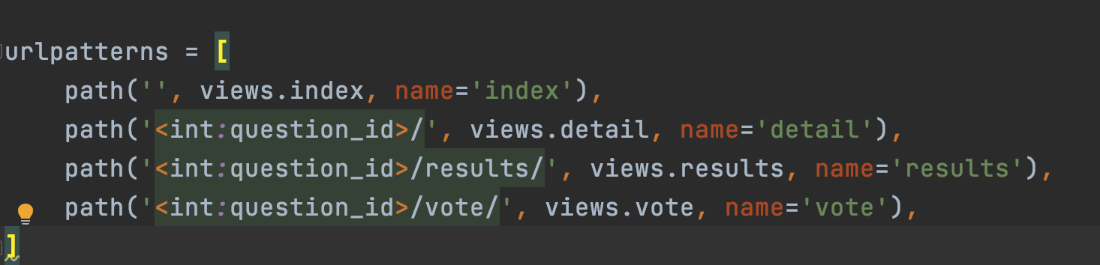
Add new views to urls
polls/urls

Slide 28
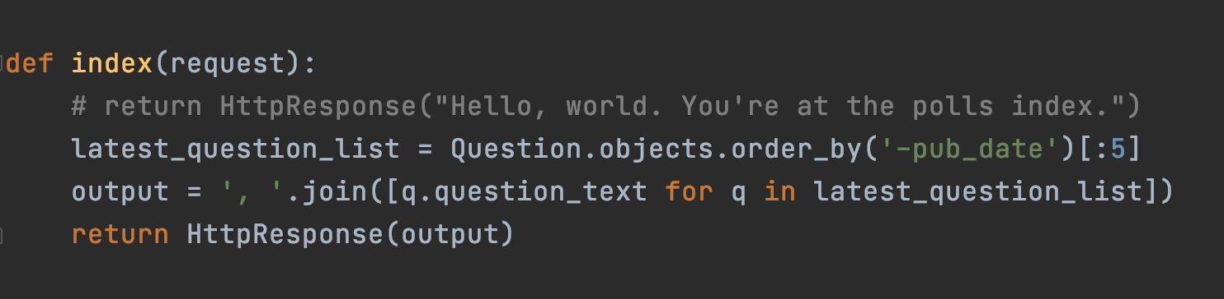
Show your questions to the index page
polls/views.py

Slide 29
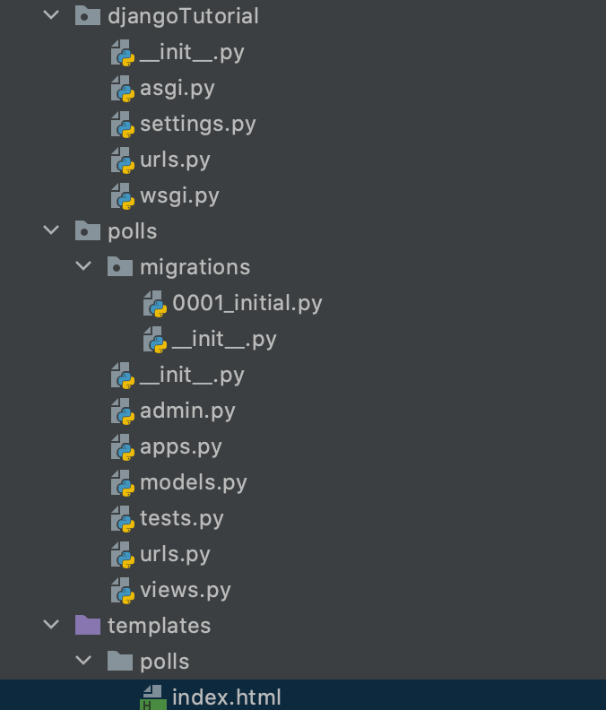
Templates
Create index.html under polls template folder

Slide 30
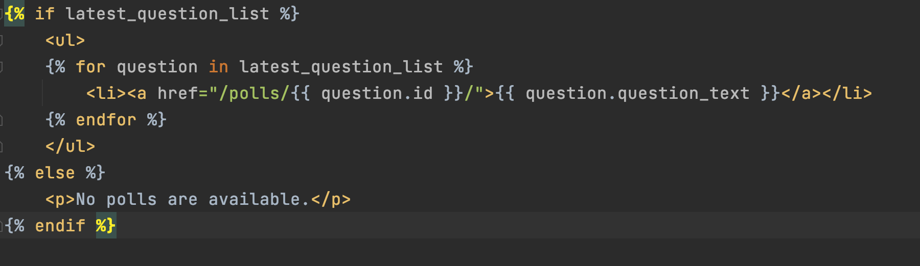
index.html

Slide 31
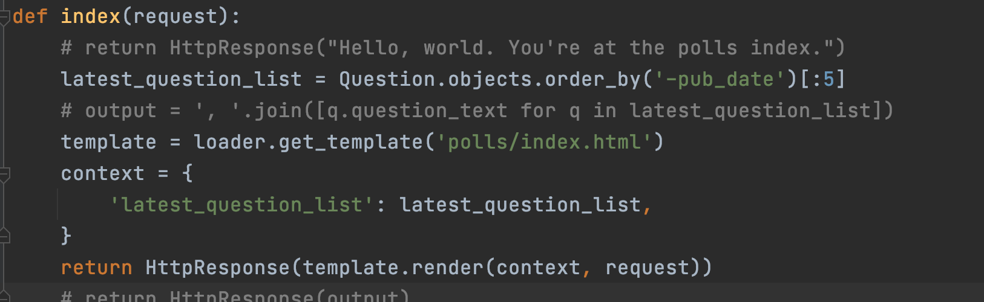
Change your questions string to list
polls/views.py

Slide 32
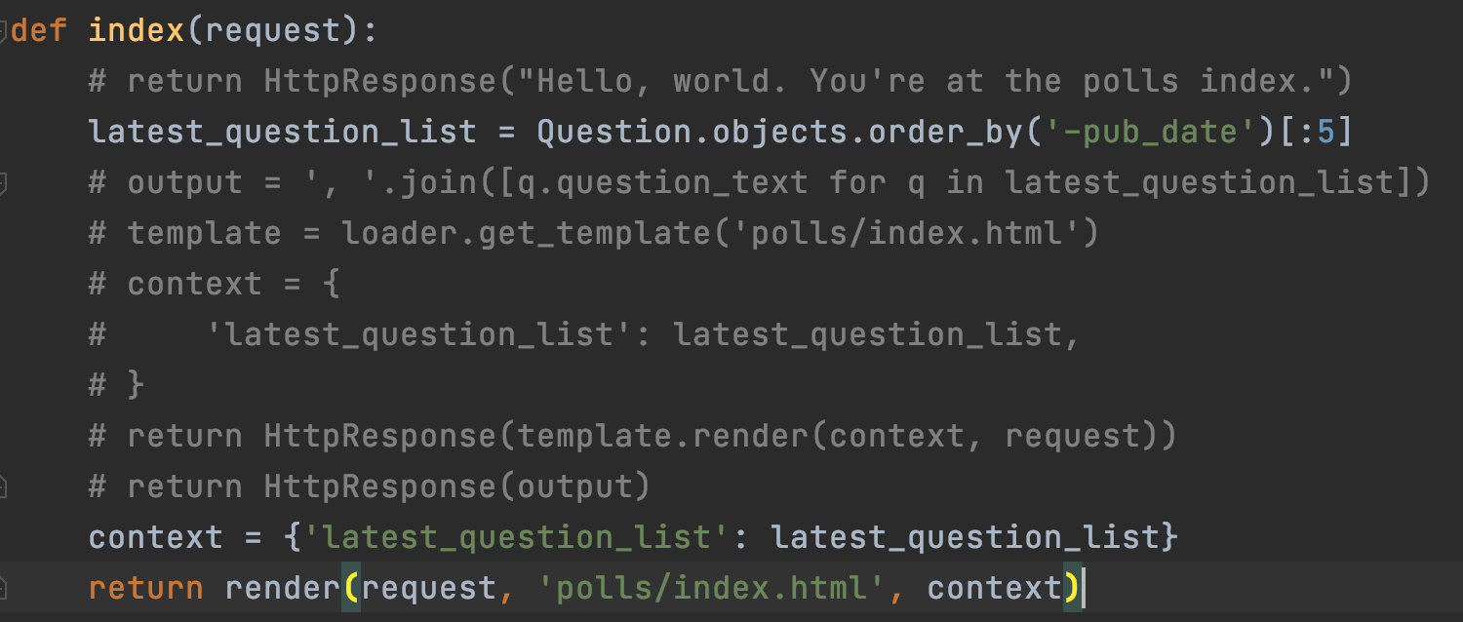
Shortcut or render
polls/views.py

Slide 33
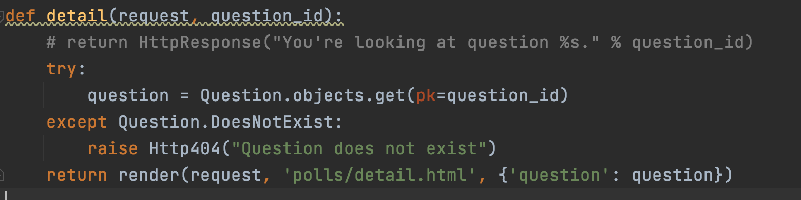
Raising a 404 error
polls/views.py

Slide 34
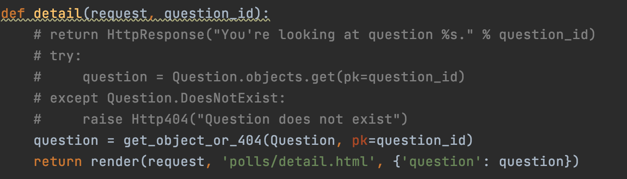
Shortcut of raising 404
polls/views.py

Slide 35
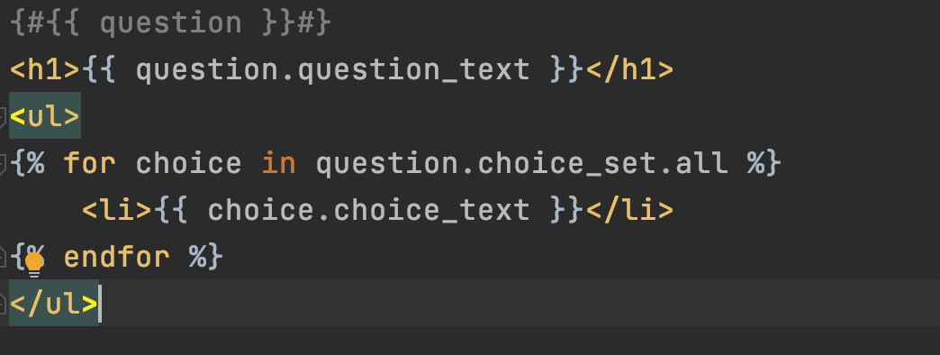
Show question text
Under template, polls/detail.html

Slide 36
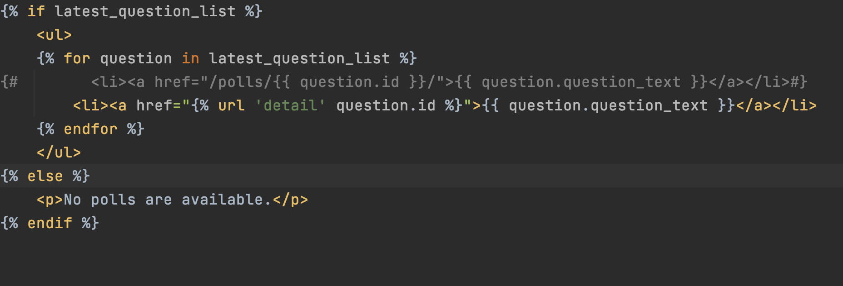
Namespacing URL names

